Slide 1
COMPREHENSIVE
H-1B VISA ANALYSIS
Group 7 (Sponsor US):
Mit Patel, Xinhua Tang, Diana Wang, Abhishek Sehgal, Mengxiao He

Slide 2
Introduction
Labor Condition Application (LCA)
Focused at helping employers and applicants understand the process of getting LCA approval
Features exploration and analysis to gather insights on how they affect the case status
Office of Foreign Labor Certification (OFLC) dataset

Slide 3
Application Process
LCA petition Submitted
LCA petition Approved
LCA petition submitted as part of
Petition for a Nonimmigrant Worker application (H1-B)

Slide 4
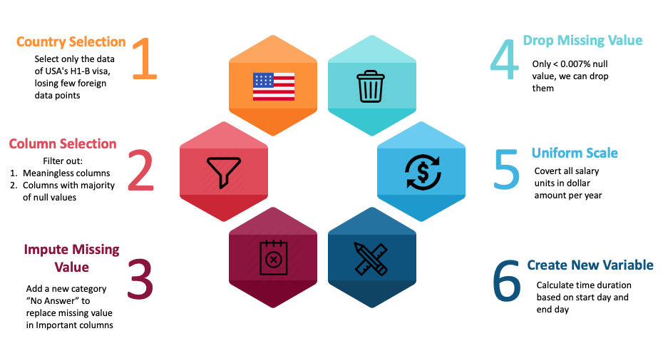
Data Processing
Notes:
In the dataset, there are 53 columns and 0.6 million rows, which is huge to analyze. To clean our data, we followed this 6 steps for data processing part.
First of all, we only want to look at data in the US. Therefore, we selected only data for USA H1B Visa and lost few foreign data points.
Then, we manually picked columns based on 2 criterias: 1. Columns must contain meaningful and analysable value. 2. Columns must contain no more than 80% missing value.
Now, we have only 37 columns left and we are able to deal with missing value. For some important categorical columns, we added a new category called ‘No Answer’ to replace missing value. After that, since there are only <.007% null value in the rest of the columns, we can drop these rows.
Next, after checking every columns, we found some inconsistent unit, so we convert them into the same unit.
The data have a better structure but still lacks useability. Some columns recorded only a date, which can not be used directly. Therefore, we applied timedelta attributes and extracted the duration based on start date and end date.

Slide 5
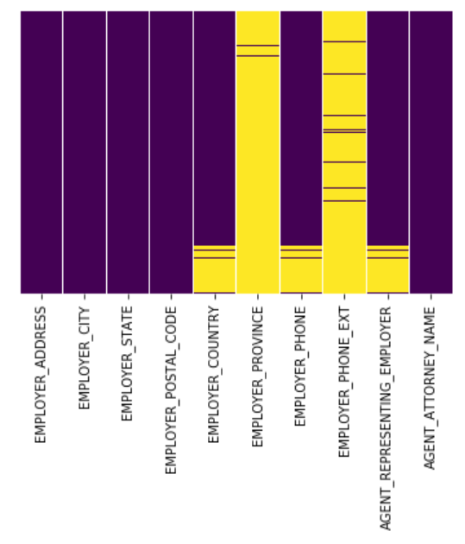
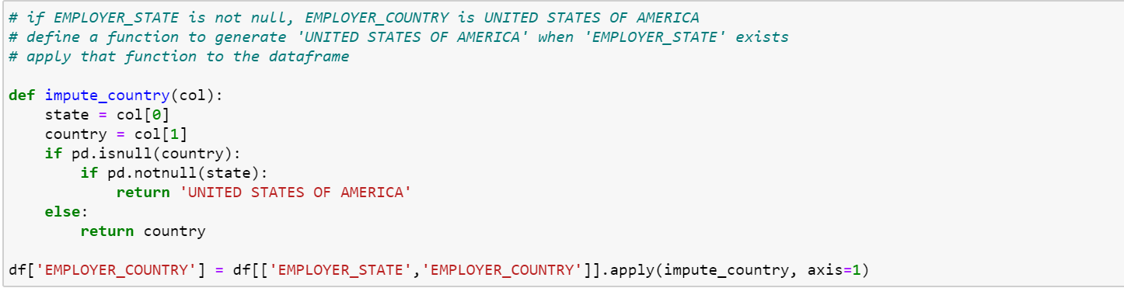
Example: null value detection and imputation
Heatmap of missing values
Drop empty columns
Impute ‘Country’ with ‘State’
Notes:
Let's look at an example of how we imputed null values. we created a heat map of a few columns and the yellow bars are the amount of null values those columns have. And as you can see Employer province and employer phone extension were totally null, so we decided to drop them. We have employer state and employer country columns, we implemented this logic where if the country value is null but if it has state filled in, we fill the missing country with USA.
Apart from this we filled null WAGE_LEVEL values with no level, assuming they dont have a wage level system.

Slide 6
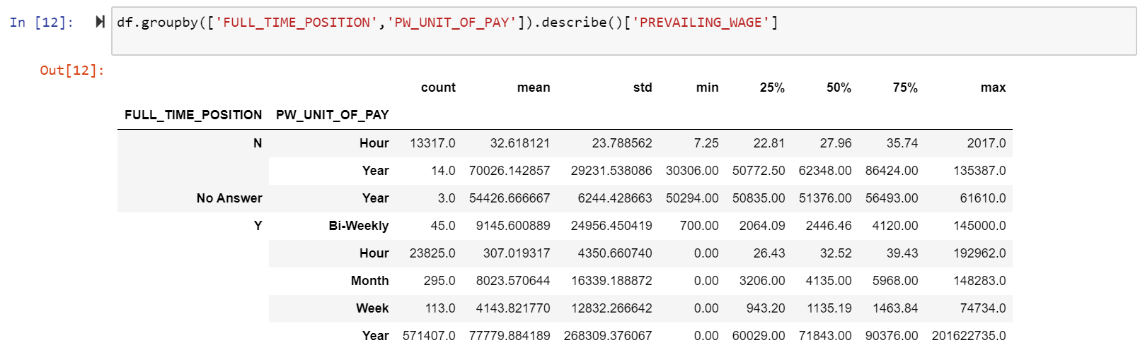
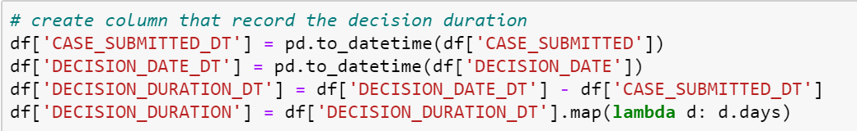
Example: data reshaping
Notes:
The table shows there are various wage units such as hourly wage, bi-weekly, monthly wage and annual wage, which need to be dealt with for future convenience. So we converted all the wage level to a single wage level, that is annual wage, so that we have a uniform scale.
Monthly pay is multiplied by 12. (as we have 12 months in a year)
Weekly pay is multiplied by 52. (as we have 52 weeks in a year)
Bi-Weekly pay is multiplied by 26. (as we have two bi-weeks in a month)
Hourly pay is multiplied by 40 * 52
Furthermore, we created a new variable called Decision Duration that calculates the time difference between date applied and the date a decision was given. It helps us to understand the decision timeline.

Slide 7
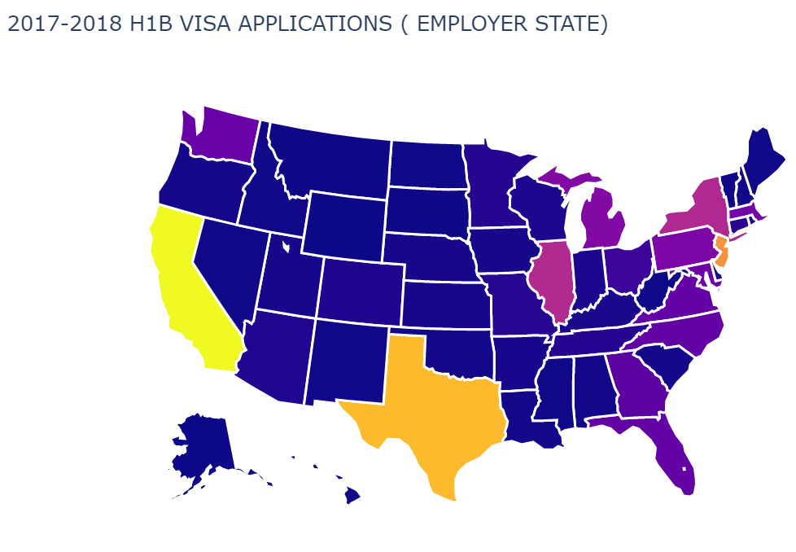
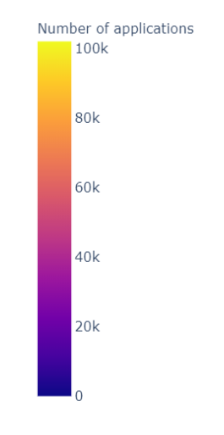
How does the number of Labor Condition Applications vary by different states in the US?
Number of applications per state
HUB of big corporates
More applications signifies approval chances

Slide 8

Which occupations are more likely to be certified? How do they pay?
A trade-off between salary and certification rate
Dominance of technical occupations
Management Analysts
Notes:
Overall high admission rate and salary level.

Slide 9
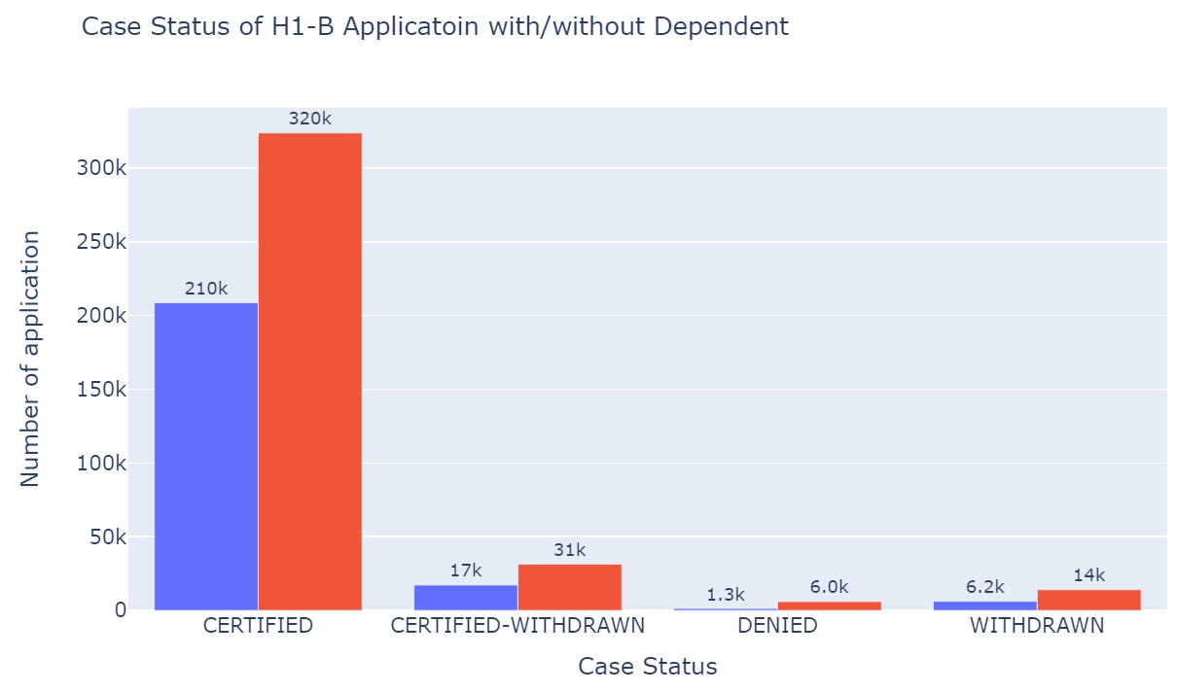
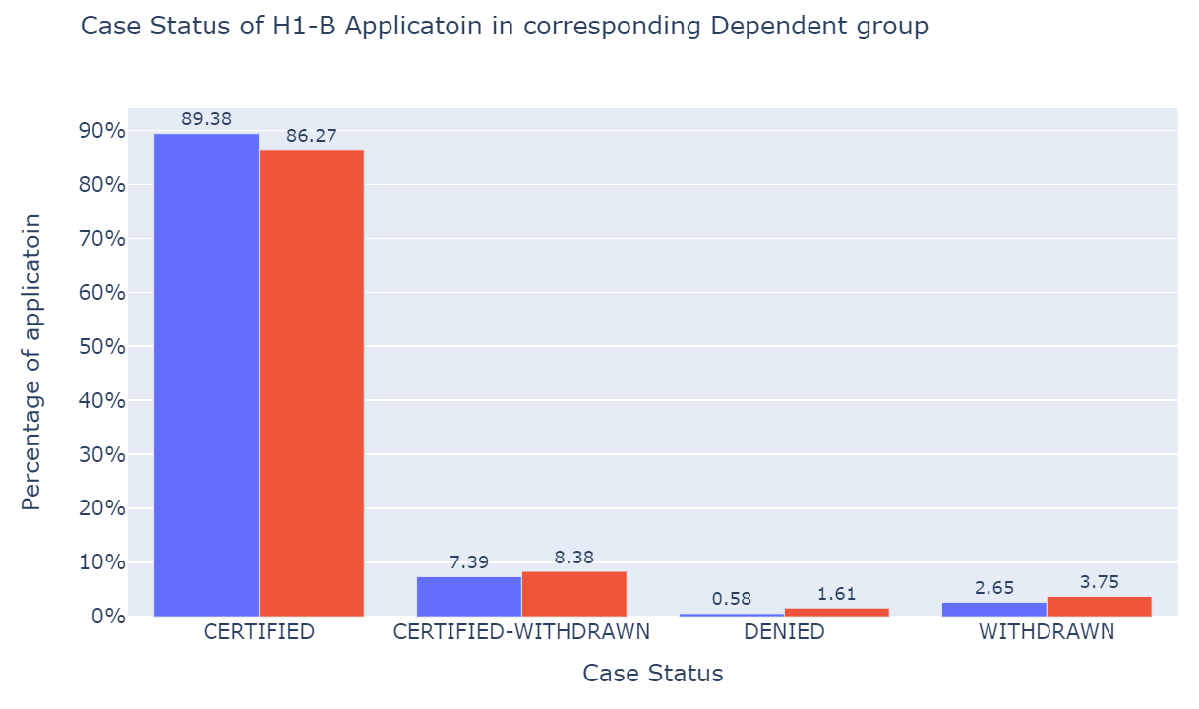

Does having a H1B dependent employer affect the application process?
Number of applications
Approval rate of applications
Non-dependent > Dependent
Non-dependent < Dependent

Slide 10
Conclusions
Target tech giants and large consulting companies
Large volume of applicants with high successful rates
Explore California, Texas or New Jersey
Most certified applicants across the US
Generally, be technical, or be specialized
Positions absorbing the most foreign specialists and are well-paid
Look for H1B dependent employers but no need to worry too much
The approval rate between each other is only slightly different

Slide 11
Thank You

